Slide 1

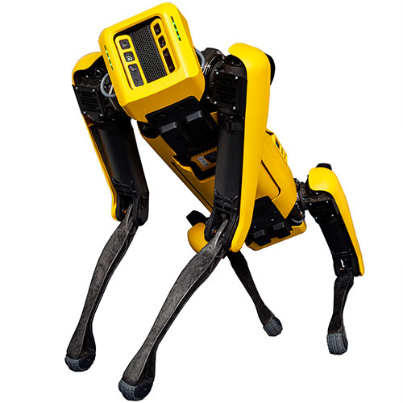
Quadruped Robot UMD Spot-mini
-Under guidance
Prof. Chad Kessens
-By
Toyas Dhake (116507271)
Raghav Agrawal (115078055)

Slide 2
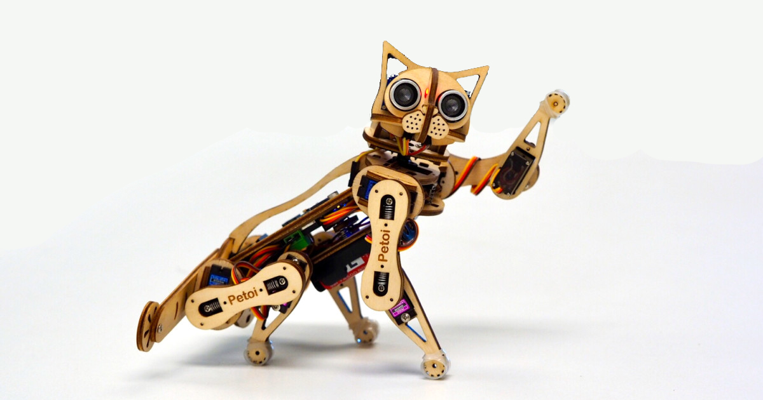
Introduction
Quadruped means animal with 4 feet.
SpotMini
Laikago
Cheetah
Nybble

Slide 3
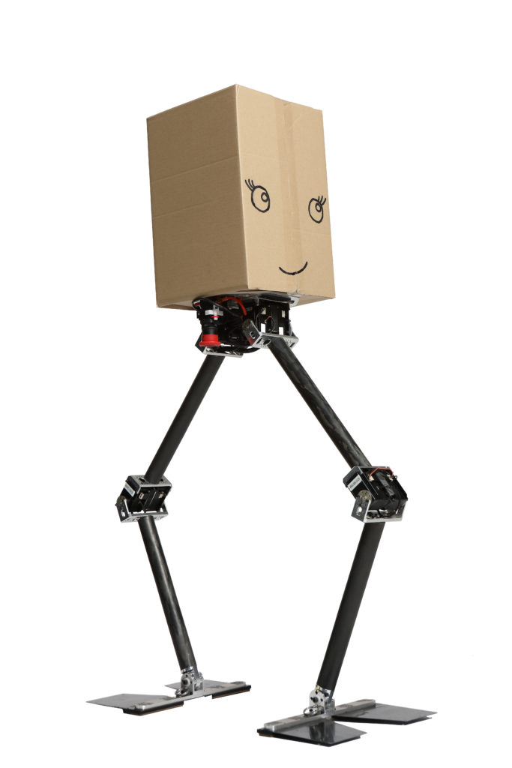
Why quadruped?
No wheels in nature.
Bipedal robot are too unstable.

Slide 4
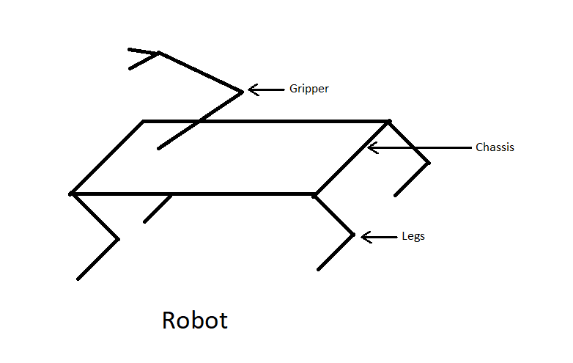
Robot Description
UMD Spot-mini has 4 legs each with 3 degrees of freedom.
Gripper on top of it with 5 degrees of freedom.

Slide 5
Assumptions
Motors have infinite Torque.
All links are rigid.
All joints are frictionless.
There is no backlash in motors.
Quasistatic motion.

Slide 6
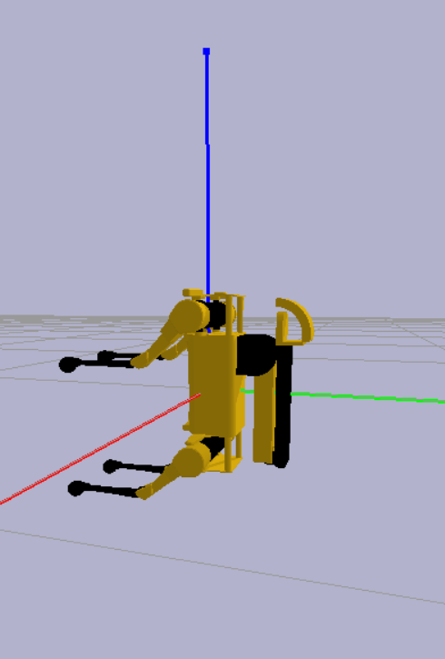
Forward Kinematics
There is no fixed reference point.
Moreover forward and inverse kinematics is needed to be calculated for all four legs and gripper.
Taking Center of Gravity as reference.

Slide 7
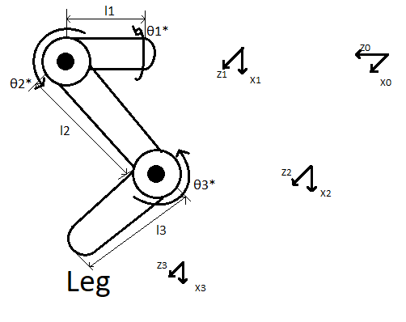
DH Table (Leg)
Frames | θ | d | a | α
0-1 | θ₁*-90 | l₁ | 0 | -90
1-2 | θ₂* | 0 | l₂ | 0
2-3 | θ₃* | 0 | l₃ | 0

Slide 8
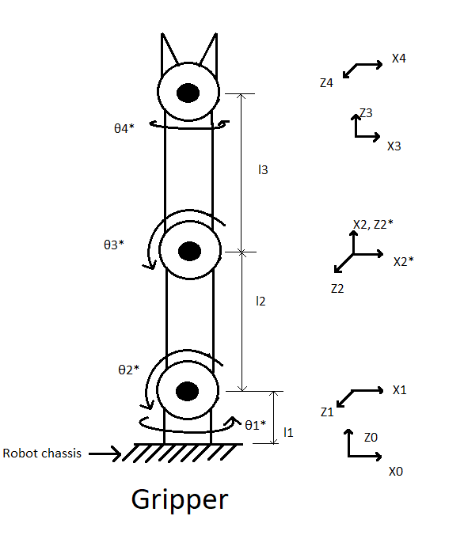
DH Table (Gripper)
Frames | θ | d | a | α
0-1 | θ₁* | l₁ | 0 | 90
1-2 | θ₂*+90 | 0 | l₂ | 0
2-2* | θ₃*-90 | 0 | 0 | -90
2*-3 | 0 | l₃ | 0 | 0
3-4 | θ₄* | l₄ | 0 | 90

Slide 9
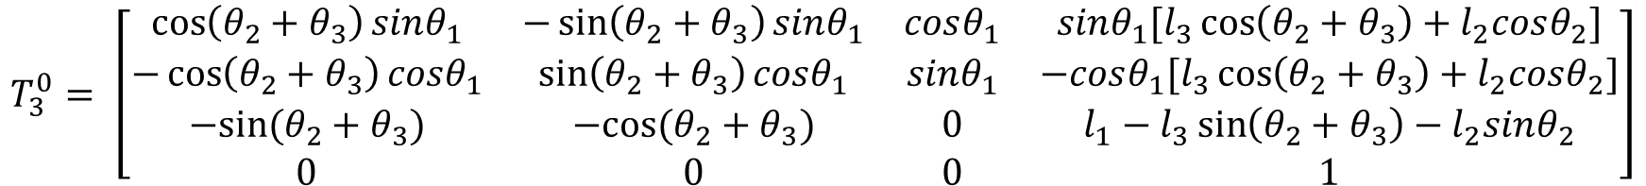
Forward Kinematics (Leg)
$$T_{3}^{0}= \left[\begin{matrix}\cos\left(θ_{2}+θ_{3}\right)sinθ_{1} & −\sin\left(θ_{2}+θ_{3}\right)sinθ_{1} & cosθ_{1} & sinθ_{1}[l_{3}\cos\left(θ_{2}+θ_{3}\right)+l_{2}cosθ_{2}] \\ −\cos\left(θ_{2}+θ_{3}\right)cosθ_{1} & \sin\left(θ_{2}+θ_{3}\right)cosθ_{1} & sinθ_{1} & −cosθ_{1}[l_{3}\cos\left(θ_{2}+θ_{3}\right)+l_{2}cosθ_{2}] \\ −sin⁡(θ_{2}+θ_{3}) & −cos⁡(θ_{2}+θ_{3}) & 0 & l_{1}−l_{3}\sin\left(θ_{2}+θ_{3}\right)−l_{2}sinθ_{2} \\ 0 & 0 & 0 & 1\end{matrix}\right]$$

Slide 10

Forward Kinematics (Gripper)
$$T_{4}^{0}=\left[\begin{matrix}−sinθ_{1}sinθ_{4}+cosθ_{4}cosθ_{1}cos⁡(θ_{2}+θ_{3}) & −\sin\left(θ_{2}+θ_{3}\right)cosθ_{1} & cosθ_{4}sinθ_{1}+sinθ_{4}cosθ_{1}cos⁡(θ_{2}+θ_{3}) & −cosθ_{1}[\left(l_{3}+l_{4}\right)\sin\left(θ_{2}+θ_{3}\right)+l_{2}sinθ_{2}] \\ cosθ_{1}sinθ_{4}+cosθ_{4}sinθ_{1}cos⁡(θ_{2}+θ_{3}) & −\sin\left(θ_{2}+θ_{3}\right)sinθ_{1} & sinθ_{4}sinθ_{1}cos⁡(θ_{2}+θ_{3})−cosθ_{1}cosθ_{4} & −sinθ_{1}[\left(l_{3}+l_{4}\right)\sin\left(θ_{2}+θ_{3}\right)+l_{2}sinθ_{2}] \\ \sin\left(θ_{2}+θ_{3}\right)cosθ_{4} & cos⁡(θ_{2}+θ_{3}) & \sin\left(θ_{2}+θ_{3}\right)sinθ_{4} & l_{1}+\left(l_{3}+l_{4}\right)\cos\left(θ_{2}+θ_{3}\right)+l_{2}cosθ_{2} \\ 0 & 0 & 0 & 1\end{matrix}\right]$$

Slide 11

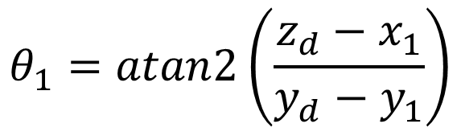
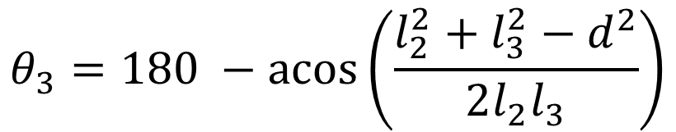
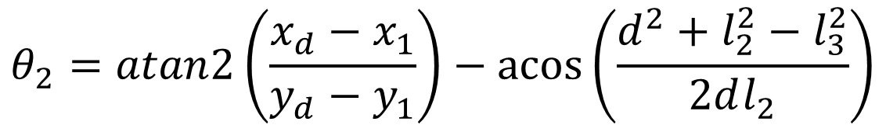
Inverse Kinematics (Leg)
$$d= \sqrt{{{(x}_{d}−x_{1})}^{2}+{(y_{d}−y_{1})}^{2} + {\left(z_{d}−z_{1}\right)}^{2}}$$
$$θ_{1}=atan2\left(\frac{z_{d}−x_{1}}{y_{d}−y_{1}}\right)$$
$$θ_{2}=atan2\left(\frac{x_{d}−x_{1}}{y_{d}−y_{1}}\right)−\operatorname{acos}\left(\frac{d^{2}+l_{2}^{2}−l_{3}^{2}}{2dl_{2}}\right)$$
$$θ_{3}=180 −\operatorname{acos}\left(\frac{l_{2}^{2}+l_{3}^{2}−d^{2}}{2l_{2}l_{3}}\right)$$

Slide 12
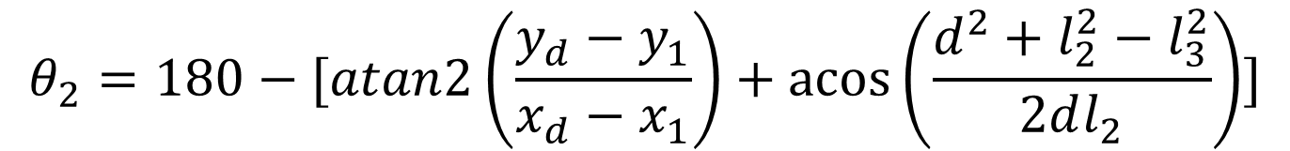
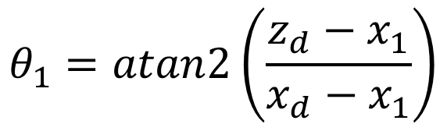
Inverse Kinematics (Gripper)
$$d= \sqrt{{{(x}_{d}−x_{1})}^{2}+{(y_{d}−y_{1})}^{2} + {\left(z_{d}−z_{1}\right)}^{2}}$$
$$θ_{1}=atan2\left(\frac{z_{d}−x_{1}}{x_{d}−x_{1}}\right)$$
$$θ_{2}=180−[atan2\left(\frac{y_{d}−y_{1}}{x_{d}−x_{1}}\right)+\operatorname{acos}\left(\frac{d^{2}+l_{2}^{2}−l_{3}^{2}}{2dl_{2}}\right)]$$
$$θ_{3}=180 −\operatorname{acos}\left(\frac{l_{2}^{2}+l_{3}^{2}−d^{2}}{2l_{2}l_{3}}\right)$$

Slide 13
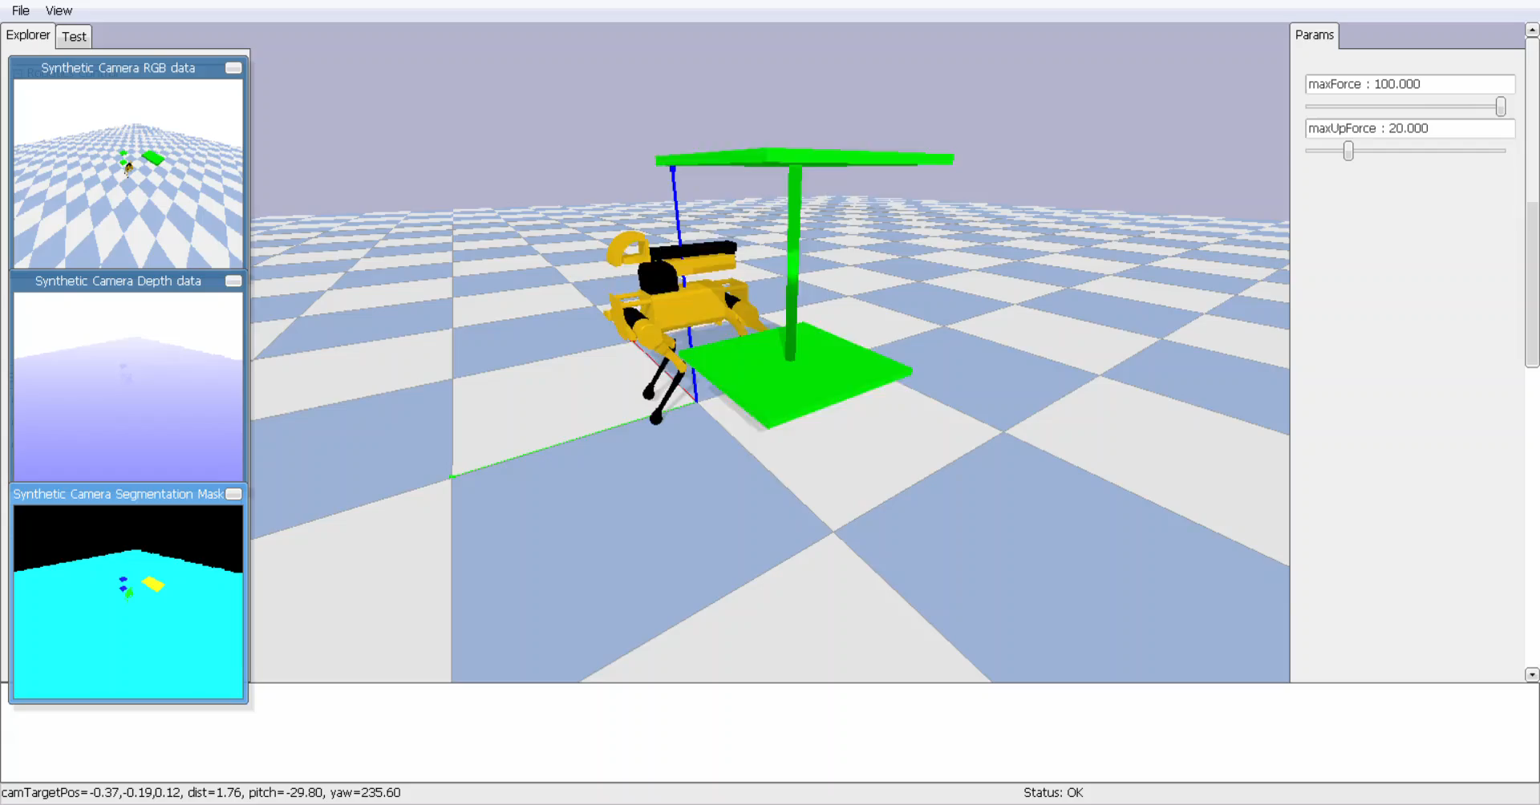
Pick up Sequence
Use inverse kinematics for object location.
Point and check gripper location by forward kinematics just to be sure.
Grip.
Get back to original position.

Slide 14
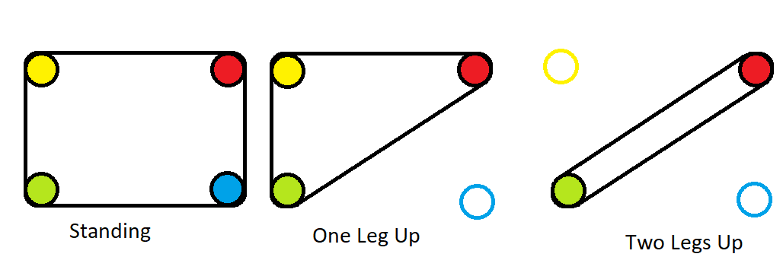
Walking

Slide 15
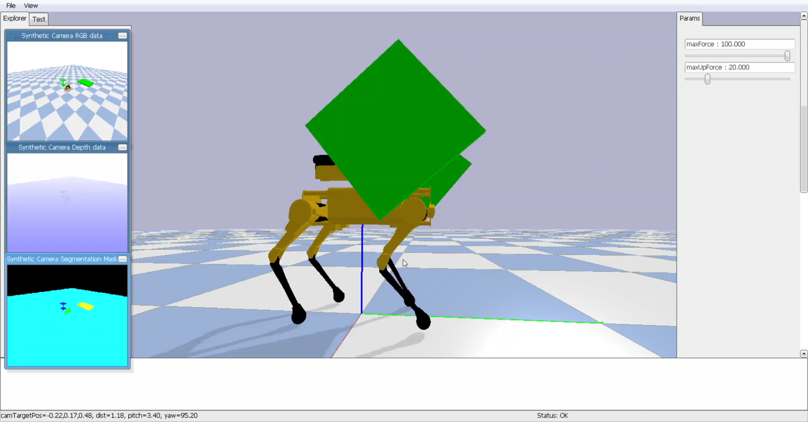
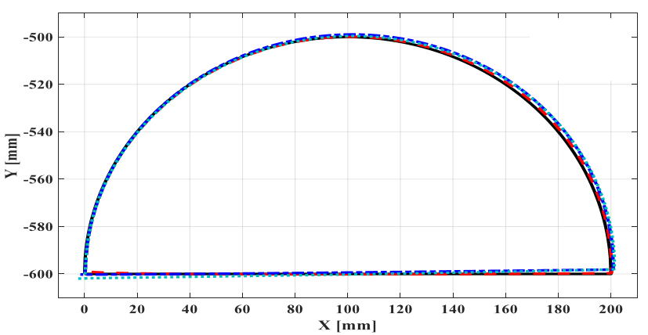
Walking Sequence
Trot isn’t too slow or too unstable to implement.
Fast movement can be used to mitigate problem of support polygon.

Slide 16
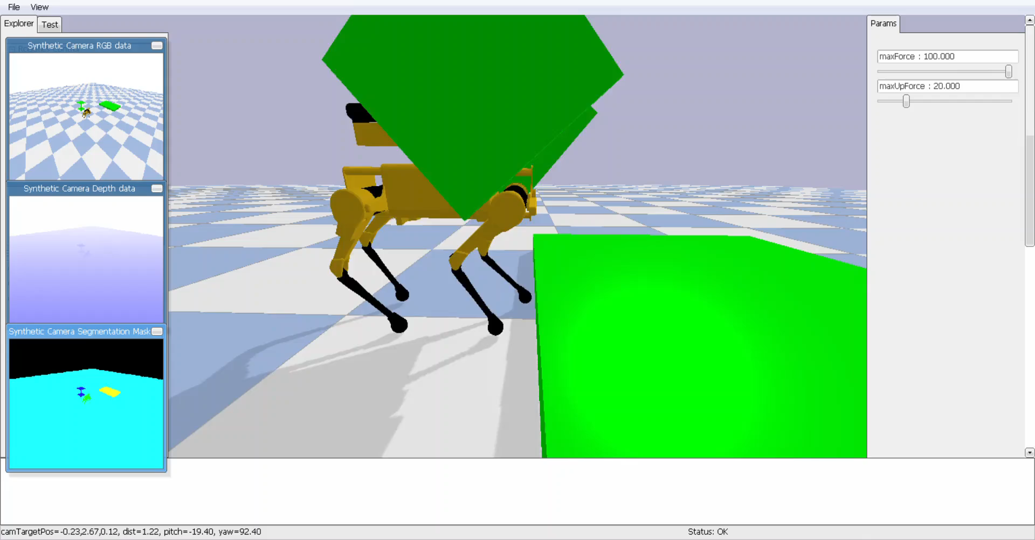
Climb Sequence
Get front legs on platform.
Use rear legs to push slowly.
Jump as far possible with rear legs below.
Quickly pull rear legs up.

Slide 17
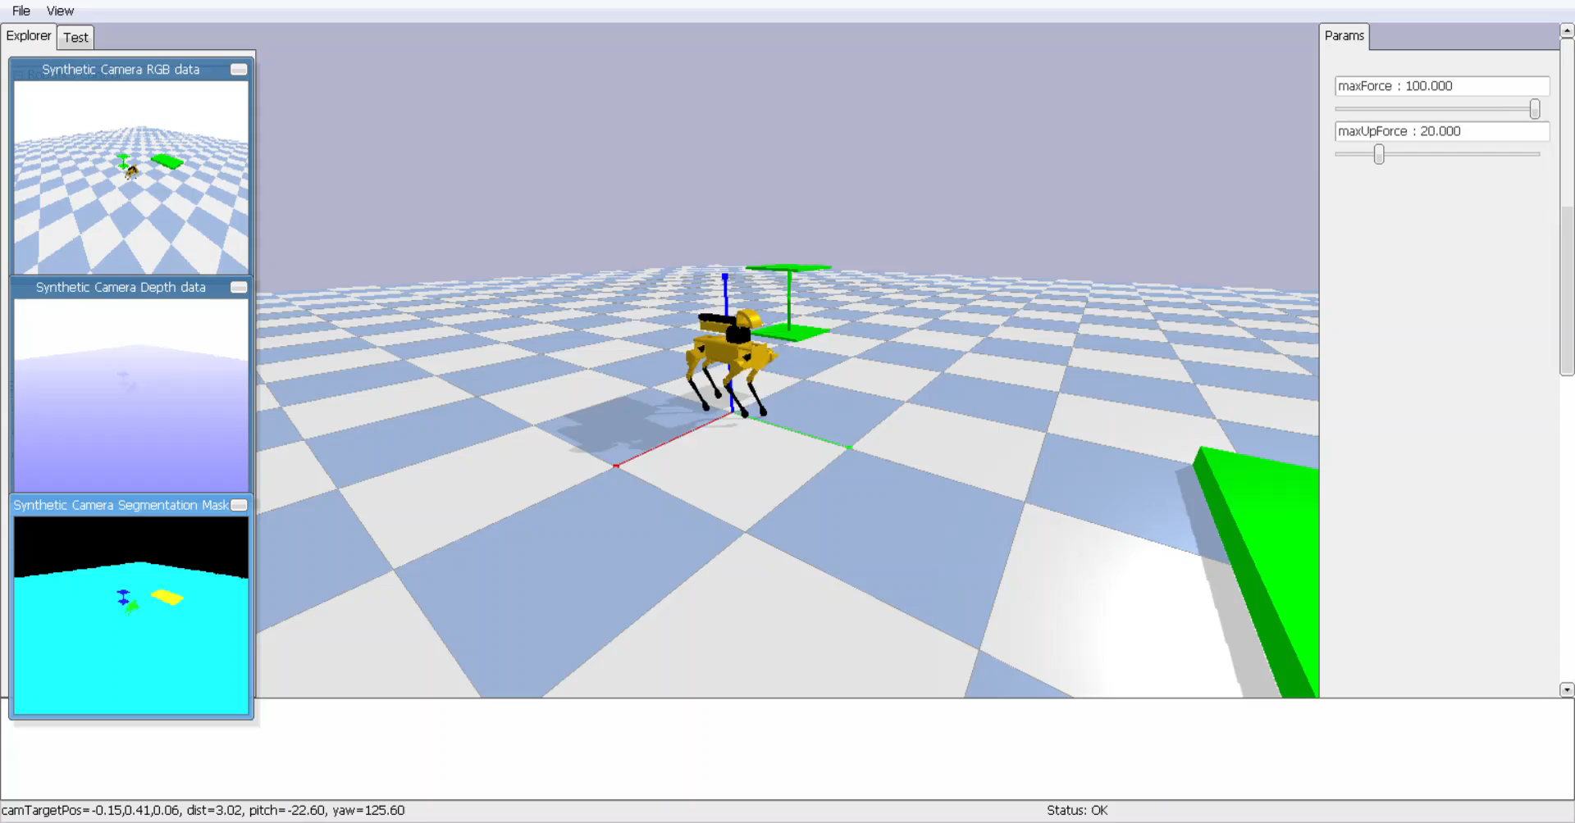
Result

Slide 18
Tools used
Pybullet
SolidWorks
PyCharm

Slide 19
References
[1]https://docs.google.com/document/d/10sXEhzFRSnvFcl3XxNGhnD4N2SedqwdAvK3dsihxVUA/edit
[2]https://github.com/bulletphysics/bullet3
[3]http://www.unitree.cc/e/action/ShowInfo.php?classid=6&id=1
[4]https://www.bostondynamics.com/spot
[5]https://www.researchgate.net/publication/335015963_Grey_Wolf_Optimizer_Based_Tuning_of_a_Hybrid_LQR-PID_Controller_for_Foot_Trajectory_Control_of_a_Quadruped_Robot

Slide 20
Questions?

Slide 21
Bloopers

Slide 22
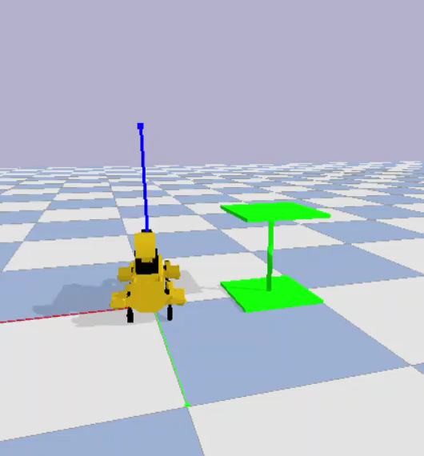
Do not use pybullet for interaction between different objects

Slide 23
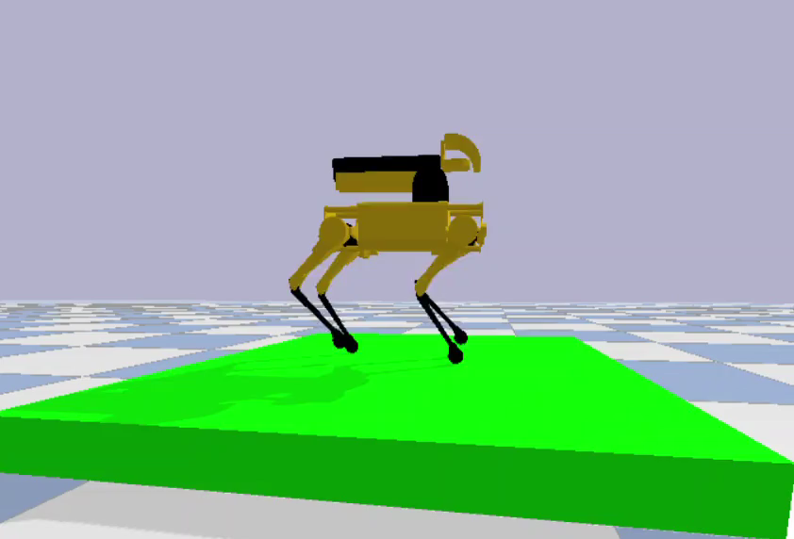
Moon walk

Slide 24
Thank you

